Slide 1
Falls Prevention Collaboration Power Point Template
This is an example of a Falls Prevention Collaboration Power Point Presentation. Consider adding your own logo, presenter/organization contact information, agency background/mission statement, local resources & photos!

Slide 2
Establish Your Partnership
Reach out to your local Fire and EMS departments to schedule a meeting to let them know about your services for older adults.
Schedule a training for each shift, so all personnel are able to participate. It’s important to provide the training annually, due to new hires & staff turnover.
Training should include falls prevention education, falls data for their community and an overview of services you offer for those at fall risk.
Training should also include your process of receiving referrals and follow up with the resident. Then finally, it is important to share outcomes with the referring agency.
Notes:
Mis

Slide 3
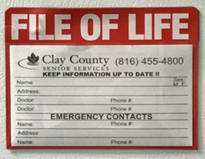
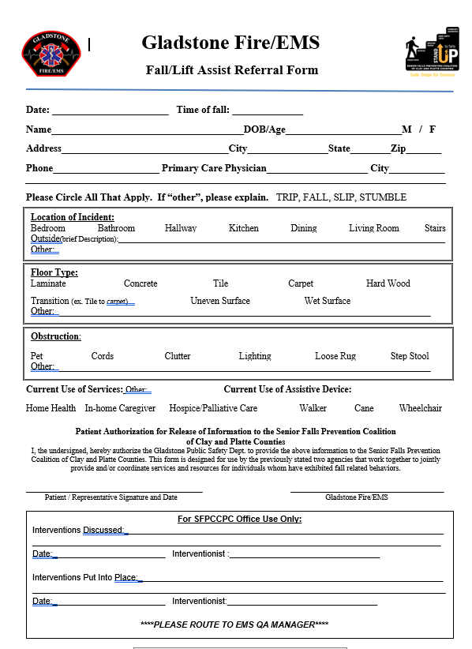
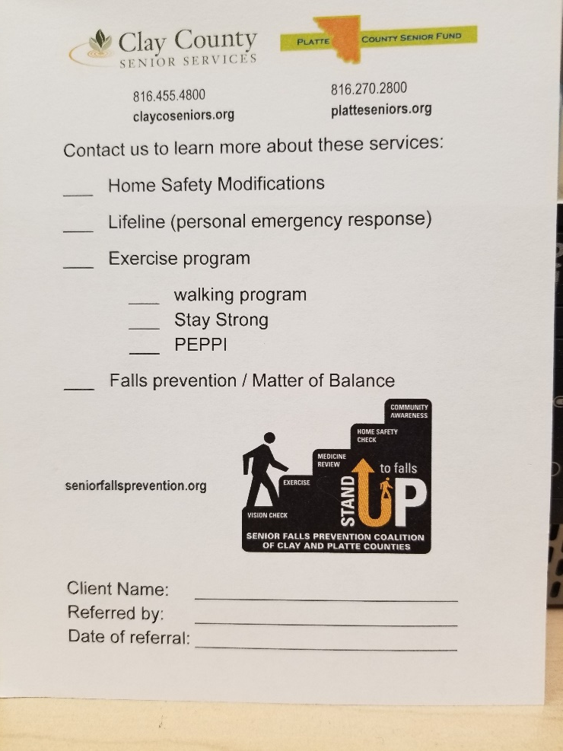
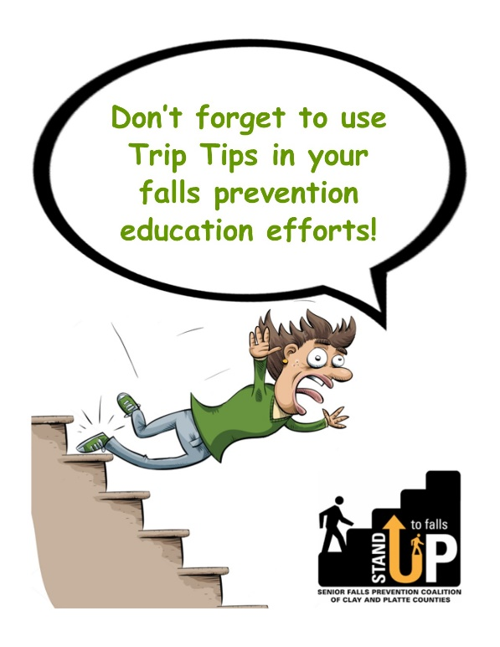
Consider these ideas for tools to use: Prescription pads, Referral Forms, Trip Tips & your agency’s promo items (File of Life, Nightlights, etc.) to provide to community partners to hand out during calls.

Slide 4
The Facts about Falls According to the Centers for Disease Control (CDC) and Missouri Department of Health & Senior Services:
Falls result in the highest # of emergency room visits and hospitalizations over all other unintentional injuries.
Fall Death Rates in the U.S. increased by 30% from 2009-2018 for older adults.
Missouri’s rate of injury for seniors due to falls is 31% higher than the national average.
About $50 billion is spent annually on healthcare related to non-fatal falls and $754 Million is spent related to fatal falls, with 75% paid by Medicare and Medicaid.
Notes:
Mis

Slide 5
More Facts about Falls
Nearly half of fall-injury cases among MO older adults occur at home.
Seniors with chronic illnesses such as Arthritis , COPD, and Hypertension are particular “red flags” for fall risks.
Seniors with chronic pain are 1.5 times more likely to fall.
Less than half of the Medicare beneficiaries who fall talked to their heath care provider about it.
About $50 billion is spent annually on healthcare related to Non-fatal falls and $754 Million is spent related to fatal falls, with ¾ paid by Medicare and Medicaid.
Admission to a long term care facility is often a result of a fall.
Many people who fall, even if they are not injured, develop a fear of falling.

Slide 6
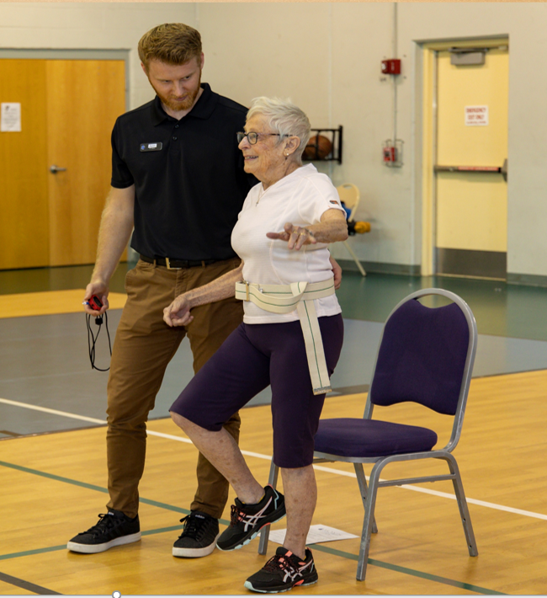
Fall Risk Factors
Multiple risk factors—some are modifiable
Lower body weakness
Difficulties with gait and balance
Use of psychoactive & OTC medications
Postural dizziness
Problems with feet and/or shoes.

Slide 7
The Good News!
The good news is that falls are not an inevitable part of aging. They can be prevented by making lifestyle changes and understanding common issues that put anyone at risk for falls.
Modify the risk.
Reduce the number of falls.

Slide 8
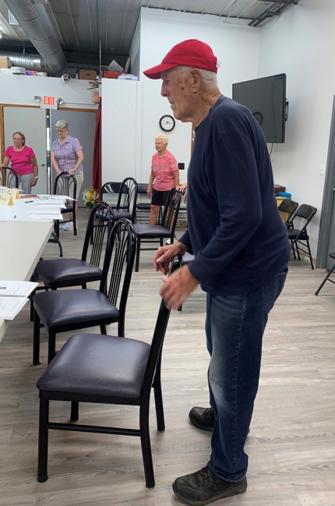
The Importance of Multifactorial Interventions
History, Physical Exam, Functional Assessment
Exercise Component: Matter of Balance - Stay Strong - Tai Chi
Environmental Adaptation
Medication review
Vitamin D (800 IU)
Vision check

Slide 9
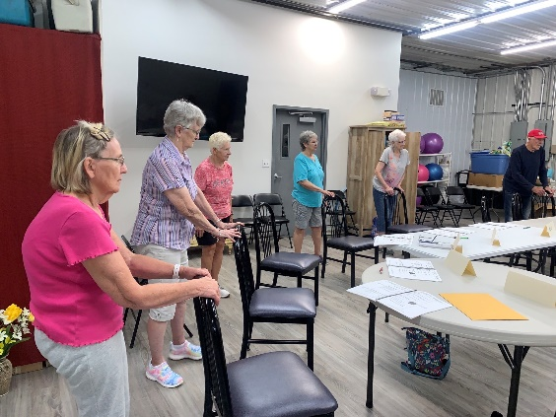
A Matter of Balance developed by Boston University
The MOB course is an 8 session (2 hours each) workshop that helps participants learn how to:
View falls and the fear of falling as controllable;
Set realistic goals for increasing activity;
Change their environment to reduce fall risk factors;
Promote exercise to increase strength and balance.

Slide 10
Stay Strong (Stay Healthy)
Offered by University of Missouri Extension
Stay Strong (Stay Healthy) is a 10-week strength-training program for middle-aged and older adults. SSSH is modeled after the evidence-based StrongWomen program developed by researchers at the Friedman School of Nutrition Science at Tufts University.

Slide 11
Tai Chi
Tai Chi’s slow, even, continuous movements make this an ideal exercise for women and men of all ages and abilities.
Tai chi differs from other types of exercise in several respects. The movements are usually circular and never forced, the muscles are relaxed rather than tensed, the joints are not fully extended or bent, and connective tissues are not stretched. (Harvard Medical School)
Research has shown that Tai Chi is beneficial for improving balance and strength.
Notes:
The

Slide 12
Vitamin D and Exercise https://www.aafp.org/pubs/afp/issues/2012/1215/od3.html
1 in 10 falls in older adults end in serious injury such as a broken bone. If we can prevent falls, we can prevent broken bones of the hip, spine and wrist.
Vitamin D deficiency is a risk factor for both falls and broken bones. Daily vitamin D intakes of 800-1000 IU (international units) and 1200 mg (milligrams) of calcium are associated with reduced falls and broken bones in older adults.
Regular physical activity and exercises that combine weight, muscle strengthening and balance helps reduce the risk of falls and actually improves the health of your bones.
Notes:
This information from the National Organization of Chronic Disease Directors because osteoporosis and falls are linked.

Slide 13
Environmental Adaptation – Make your home safer
Remove things you can trip over (clothes, shoes, books, etc.)
Remove small throw rugs or use double-sided tape.
Keep items you use often in cabinets you can easily reach without stepstool.
Have grab bars next to toilet and tub and inside tub/shower.
Use non-slip mats in bathroom.
Improve lighting in the home. Reduce glare.
Wear non-skid shoes. Avoid going barefoot.
Notes:
This is a basic checklist for safety in the home. There are some brochures you can order from the CDC to give to clients. They have been out of stock so I could not bring those. Here is what they look like.
There are also other checklists available like the ones you have from Phillips Lifeline.

Slide 14
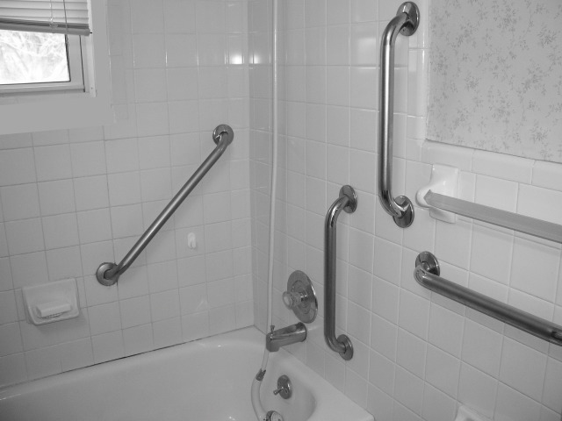
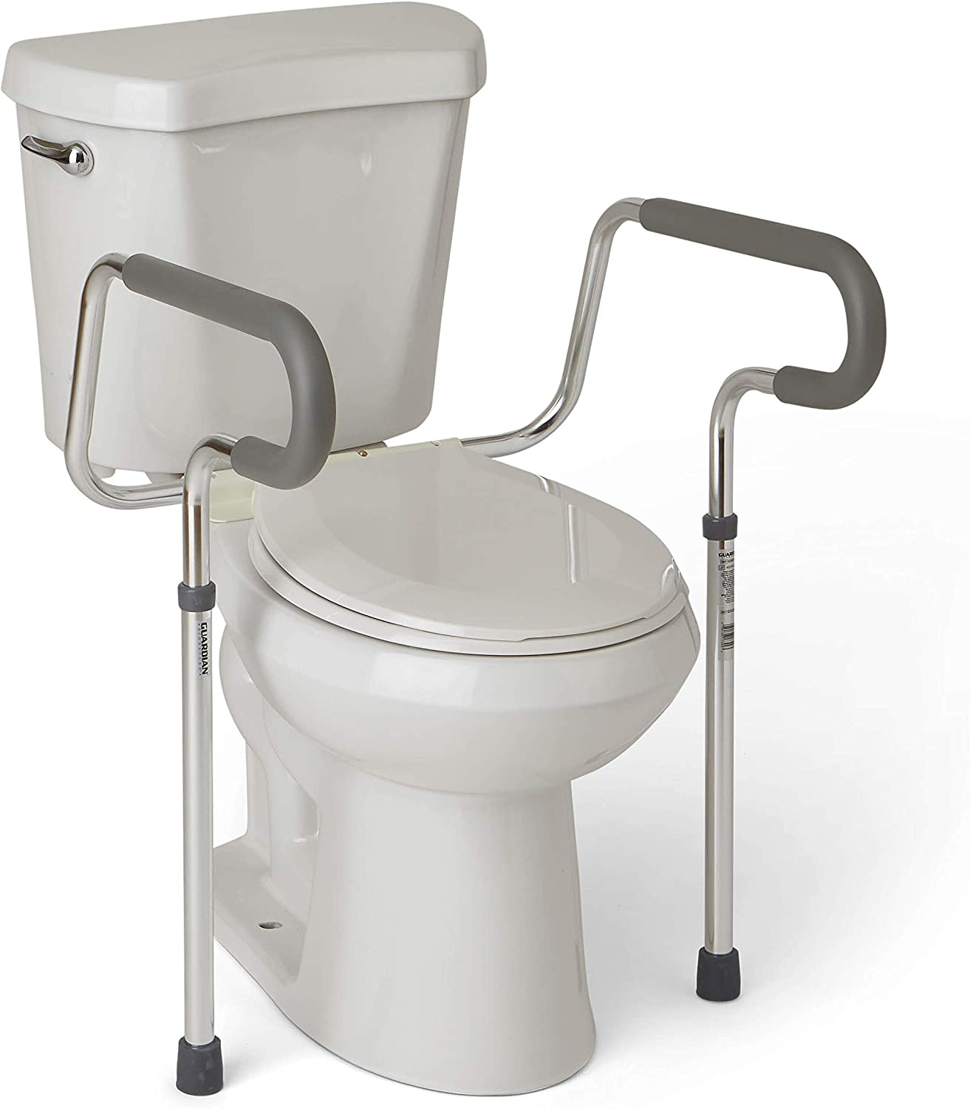
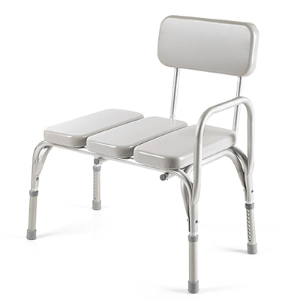
Bathroom Safety

Slide 15
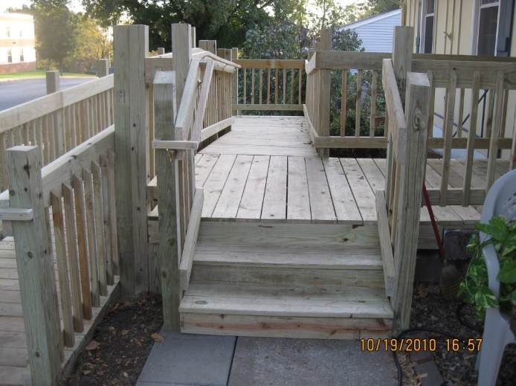
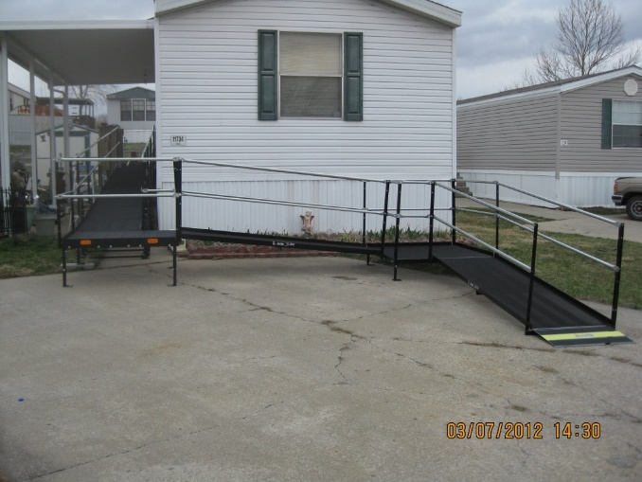
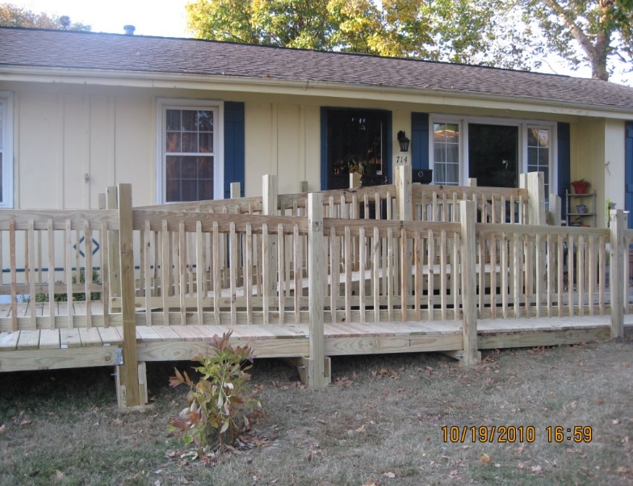
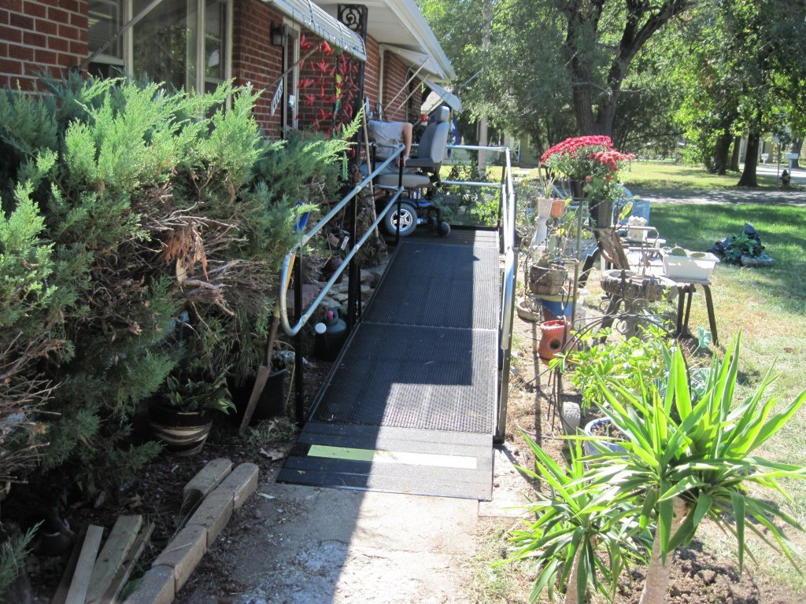
Modular Ramp & Steel Ramp Designs

Slide 16
Our primary goal and mission is to is to increase awareness and provide resources to older adults regarding fall prevention, therefore reducing the risk of falls and falls related injuries through education, awareness, and outreach.
https://health.mo.gov/seniors/showmefallsfreemissouri/

Slide 17
CDC’s Injury Center created the STEADI Tool Kit for health care providers who see older adults in their practice who are at risk of falling or who may have fallen in the past. The STEADI Tool Kit gives health care providers the information and tools they need to assess and address their older patients’ fall risk.
https://www.cdc.gov/steadi/index.html
ICD 10 updates allow physicians to bill for falls assessment and consultation.
Notes:
Our Senior Falls Prevention Coalition has begun to contact physicians’ offices to distribute these kits. I brought a few for you to look at.
The CDC website has a webinar on these kits and downloadable, printable brochures.

Slide 18
Falls Prevention Resources
Show Me Falls Free Missouri Coalition: https://health.mo.gov/seniors/showmefallsfreemissouri/
Centers for Disease Control: http://www.cdc.gov/HomeandRecreationalSafety/Falls/index.html
National Council on Aging:
https://www.ncoa.org/professionals/health/center-for-healthy-aging/national-falls-prevention- resource-center/falls-free-initiative
https://www.ncoa.org/age-well-planner/assessment/falls-free-checkup
National Institute on Aging: https://www.nia.nih.gov/health/topics/falls-and-falls-prevention
American Academy of Orthopedic Surgeons: http://orthoinfo.aaos.org/topic.cfm?topic=A00098
Notes:
These websites give some valuable information for you, so let’s take a look at them.

Slide 19
Thank you for your attention!
Questions or comments?
(Add your website address and social media accounts)
Falls Prevention Awareness Week is September 17-23, 2023
https://www.ncoa.org/article/falls-prevention-awareness-week-toolkit
Notes:
The 1st day of Fall is Falls Prevention Day each year.

